Slide 1
CS162 Operating Systems and Systems Programming Lecture 12 Address Translation
October 8, 2018
Prof. Ion Stoica
http://cs162.eecs.Berkeley.edu

Slide 2
Finishing Lecture 10

Slide 3
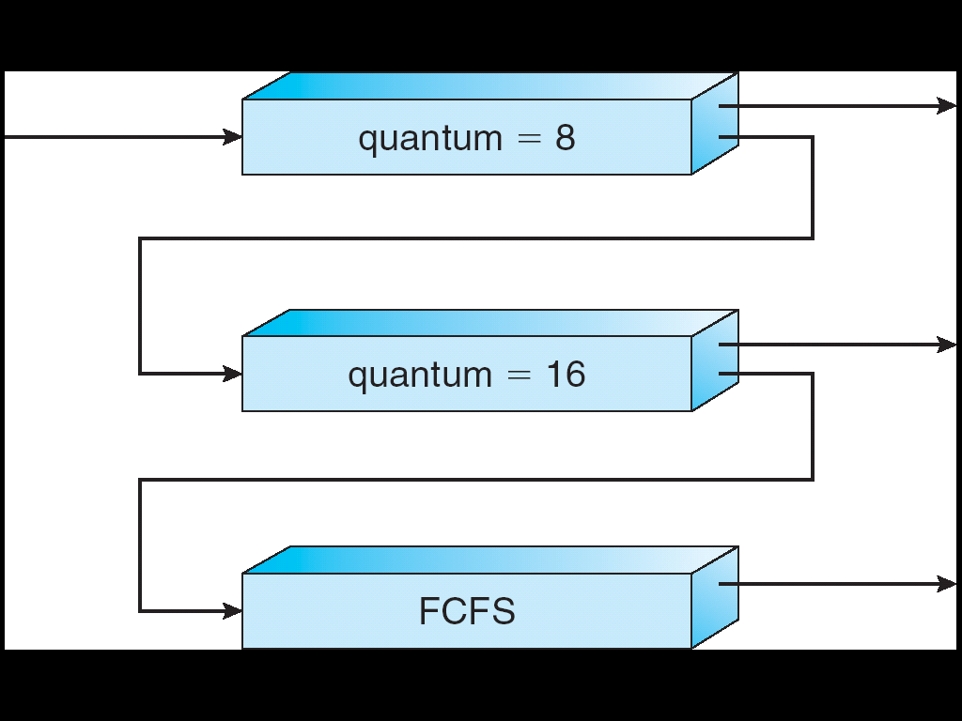
Multi-Level Feedback Scheduling
Another method for exploiting past behavior (first use in CTSS)
Multiple queues, each with different priority
Higher priority queues often considered “foreground” tasks
Each queue has its own scheduling algorithm
e.g. foreground – RR, background – FCFS
Sometimes multiple RR priorities with quantum increasing exponentially (highest:1ms, next: 2ms, next: 4ms, etc)
Adjust each job’s priority as follows (details vary)
Job starts in highest priority queue
If timeout expires, drop one level
If timeout doesn’t expire, push up one level (or to top)
Long-Running Compute Tasks Demoted to Low Priority

Slide 4
Scheduling Details
Long-Running Compute Tasks Demoted to Low Priority
Result approximates SRTF:
CPU bound jobs drop like a rock
Short-running I/O bound jobs stay near top
Scheduling must be done between the queues
Fixed priority scheduling:
serve all from highest priority, then next priority, etc.
Time slice:
each queue gets a certain amount of CPU time
e.g., 70% to highest, 20% next, 10% lowest

Slide 5
Scheduling Details
Long-Running Compute Tasks Demoted to Low Priority
Countermeasure: user action that can foil intent of OS designers
For multilevel feedback, put in a bunch of meaningless I/O to keep job’s priority high
Of course, if everyone did this, wouldn’t work!
Example of Othello program:
Playing against competitor, so key was to do computing at higher priority the competitors.
Put in printf’s, ran much faster!

Slide 6
Real-Time Scheduling (RTS)
Efficiency is important but predictability is essential:
We need to predict with confidence worst case response times for systems
In RTS, performance guarantees are:
Task- and/or class centric and often ensured a priori
In conventional systems, performance is:
System/throughput oriented with post-processing (… wait and see …)
Real-time is about enforcing predictability, and does not equal fast computing!!!
Hard Real-Time
Attempt to meet all deadlines
EDF (Earliest Deadline First), LLF (Least Laxity First), RMS (Rate-Monotonic Scheduling), DM (Deadline Monotonic Scheduling)
Soft Real-Time
Attempt to meet deadlines with high probability
Minimize miss ratio / maximize completion ratio (firm real-time)
Important for multimedia applications
CBS (Constant Bandwidth Server)

Slide 7
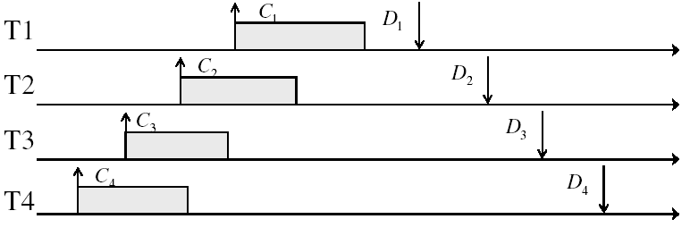
Example: Workload Characteristics
Tasks are preemptable, independent with arbitrary arrival (=release) times
Tasks have deadlines (D) and known computation times (C)
Example Setup:

Slide 8
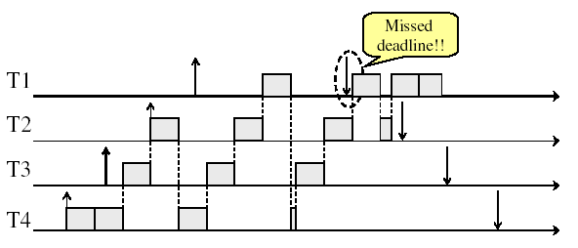
Example: Round-Robin Scheduling Doesn’t Work
Time

Slide 9
Earliest Deadline First (EDF)
Tasks periodic with period P and computation C in each period: (P, C)
Preemptive priority-based dynamic scheduling
Each task is assigned a (current) priority based on how close the absolute deadline is
The scheduler always schedules the active task with the closest absolute deadline
0
5
10
15

Slide 10
A Final Word On Scheduling
When do the details of the scheduling policy and fairness really matter?
When there aren’t enough resources to go around
When should you simply buy a faster computer?
(Or network link, or expanded highway, or …)
One approach: Buy it when it will pay for itself in improved response time
Assuming you’re paying for worse response time in reduced productivity, customer angst, etc…
Might think that you should buy a faster X when X is utilized 100%, but usually, response time goes to infinity as utilization⇒100%
An interesting implication of this curve:
Most scheduling algorithms work fine in the “linear” portion of the load curve, fail otherwise
Argues for buying a faster X when hit “knee” of curve
Response
time
100%
Utilization

Slide 11
Today’s lecture

Slide 12
Virtualizing Resources
Physical Reality: Different Processes/Threads share the same hardware
Need to multiplex CPU (done)
Need to multiplex use of Memory (Today)
Need to multiplex disk and devices (later in term)
Why worry about memory sharing?
The complete working state of a process and/or kernel is defined by its data in memory (and registers)
Consequently, two different processes cannot use the same memory
Physics: two different data cannot occupy same locations in memory
May not want different threads to have access to each other’s memory

Slide 13
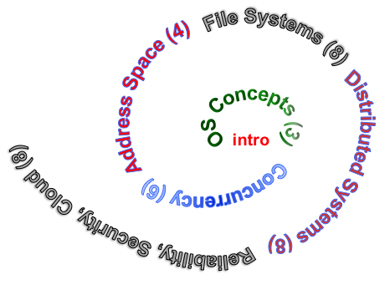
Next Objective
Dive deeper into the concepts and mechanisms of memory sharing and address translation
Enabler of many key aspects of operating systems
Protection
Multi-programming
Isolation
Memory resource management
I/O efficiency
Sharing
Inter-process communication
Demand paging
Today: Linking, Segmentation

Slide 14
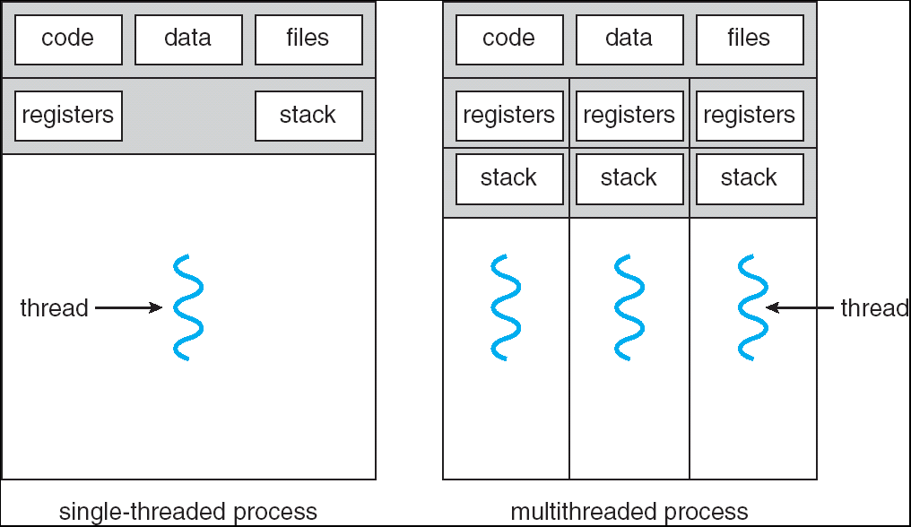
Recall: Single and Multithreaded Processes
Threads encapsulate concurrency
“Active” component of a process
Address spaces encapsulate protection
Keeps buggy program from trashing the system
“Passive” component of a process

Slide 15
Important Aspects of Memory Multiplexing (1/2)
Protection: prevent access to private memory of other processes
Kernel data protected from User programs
Programs protected from themselves
May want to give special behavior to different memory regions (Read Only, Invisible to user programs, etc)
Controlled overlap: sometimes we want to share memory across processes.
E.g., communication across processes, share code
Need to control such overlap

Slide 16
Important Aspects of Memory Multiplexing (2/2)
Translation:
Ability to translate accesses from one address space (virtual) to a different one (physical)
When translation exists, processor uses virtual addresses, physical memory uses physical addresses
Side effects:
Can be used to give uniform view of memory to programs
Can be used to provide protection (e.g., avoid overlap)
Can be used to control overlap

Slide 17
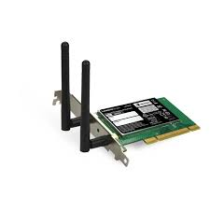
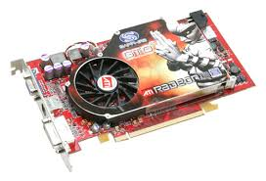


Recall: Loading
Threads
Address Spaces
Windows
Processes
Files
Sockets
Software
OS Hardware Virtualization
Hardware
ISA
Memory
Processor
Protection Boundary
OS
Ctrlr
storage
Networks
Displays
Inputs

Slide 18
Binding of Instructions and Data to Memory
Assume 4byte words
0x300 = 4 * 0x0C0
0x0C0 = 0000 1100 0000
0x300 = 0011 0000 0000
Process view of memory
Physical addresses
data1: dw 32
…
start: lw r1,0(data1)
jal checkit
loop: addi r1, r1, -1
bnz r1, loop …
checkit: …
0x0300 00000020
… …
0x0900 8C2000C0
0x0904 0C000280
0x0908 2021FFFF
0x090C 14200242
…
0x0A00

Slide 19
Binding of Instructions and Data to Memory
Physical
Memory
0x0000
0x0300
00000020
Process view of memory
Physical addresses
data1: dw 32
…
start: lw r1,0(data1)
jal checkit
loop: addi r1, r1, -1
bnz r1, loop …
checkit: …
0x0300 00000020
… …
0x0900 8C2000C0
0x0904 0C000280
0x0908 2021FFFF
0x090C 14200242
…
0x0A00
0x0900
8C2000C0
0C000340
2021FFFF
14200242
0xFFFF

Slide 20
Second copy of program from previous example
Physical
Memory
0x0000
0x0300
App X
Process view of memory
Physical addresses
data1: dw 32
…
start: lw r1,0(data1)
jal checkit
loop: addi r1, r1, -1
bnz r1, r0, loop …
checkit: …
0x0300 00000020
… …
0x0900 8C2000C0
0x0904 0C000280
0x0908 2021FFFF
0x090C 14200242
…
0x0A00
0x0900
?
0xFFFF
Need address translation!

Slide 21
Second copy of program from previous example
Physical Memory
0x0000
0x0300
App X
Process view of memory
Processor view of memory
data1: dw 32
…
start: lw r1,0(data1)
jal checkit
loop: addi r1, r1, -1
bnz r1, r0, loop …
checkit: …
0x1300 00000020
… …
0x1900 8C2004C0
0x1904 0C000680
0x1908 2021FFFF
0x190C 14200642
…
0x1A00
0x0900
0x1300
00000020
0x1900
8C2004C0
0C000680
2021FFFF
14200642
One of many possible translations!
Where does translation take place?
Compile time, Link/Load time, or Execution time?
0xFFFF

Slide 22
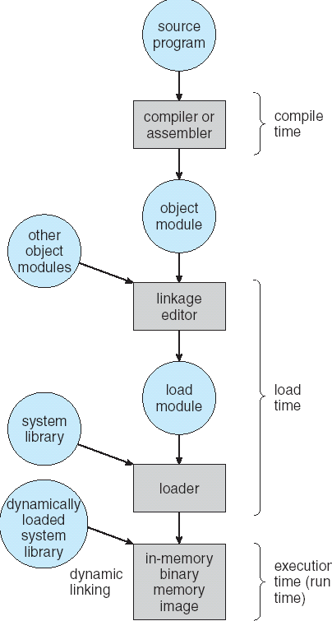
Multi-step Processing of a Program for Execution
Preparation of a program for execution involves components at:
Compile time (i.e., “gcc”)
Link/Load time (UNIX “ld” does link)
Execution time (e.g., dynamic libs)
Addresses can be bound to final values anywhere in this path
Depends on hardware support
Also depends on operating system
Dynamic Libraries
Linking postponed until execution
Small piece of code, stub, used to locate appropriate memory-resident library routine
Stub replaces itself with the address of the routine, and executes routine

Slide 23

Recall: Uniprogramming
Uniprogramming (no Translation or Protection)
Application always runs at same place in physical memory since only one application at a time
Application can access any physical address
Application given illusion of dedicated machine by giving it reality of a dedicated machine
0xFFFFFFFF
Operating
System
Valid 32-bit
Addresses
Application
0x00000000

Slide 24
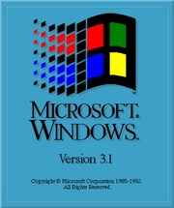
Multiprogramming (primitive stage)
Multiprogramming without Translation or Protection
Must somehow prevent address overlap between threads
Use Loader/Linker: Adjust addresses while program loaded into memory (loads, stores, jumps)
Everything adjusted to memory location of program
Translation done by a linker-loader (relocation)
Common in early days (… till Windows 3.x, 95?)
With this solution, no protection: bugs in any program can cause other programs to crash or even the OS
0xFFFFFFFF
Operating
System
Application2
0x00020000
Application1
0x00000000

Slide 25
Multiprogramming (Version with Protection)
Can we protect programs from each other without translation?
Yes: use two special registers BaseAddr and LimitAddr to prevent user from straying outside designated area
If user tries to access an illegal address, cause an error
During switch, kernel loads new base/limit from PCB (Process Control Block)
User not allowed to change base/limit registers
0xFFFFFFFF
Operating
System
LimitAddr=0x10000
0x00020000
BaseAddr=0x20000
Application2
Application1
0x00000000

Slide 26
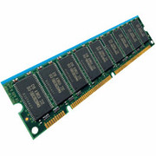
Recall: General Address translation
Virtual
Addresses
Physical
Addresses
CPU
MMU
Untranslated read or write
Recall: Address Space:
All the addresses and state a process can touch
Each process and kernel has different address space
Consequently, two views of memory:
View from the CPU (what program sees, virtual memory)
View from memory (physical memory)
Translation box (MMU) converts between the two views
Translation makes it much easier to implement protection
If task A cannot even gain access to task B’s data, no way for A to adversely affect B
With translation, every program can be linked/loaded into same region of user address space

Slide 27

Simple Example: Base and Bounds (CRAY-1)
Base
Virtual
Address
CPU
+
DRAM
Physical
Address
Bound
(Limit)
<?
No: Error!
Could use base/bounds for dynamic address translation – translation happens at execution:
Alter address of every load/store by adding “base”
Generate error if address bigger than limit
This gives program the illusion that it is running on its own dedicated machine, with memory starting at 0
Program gets continuous region of memory
Addresses within program do not have to be relocated when program placed in different region of DRAM

Slide 28
Issues with Simple B&B Method
process 6
process 6
process 6
process 6
process 5
process 5
process 5
process 9
process 9
process 11
process 2
process 10
OS
OS
OS
OS
Fragmentation problem over time
Not every process is same size ➔ memory becomes fragmented
Missing support for sparse address space
Would like to have multiple chunks/program (Code, Data, Stack)
Hard to do inter-process sharing
Want to share code segments when possible
Want to share memory between processes
Helped by providing multiple segments per process

Slide 29
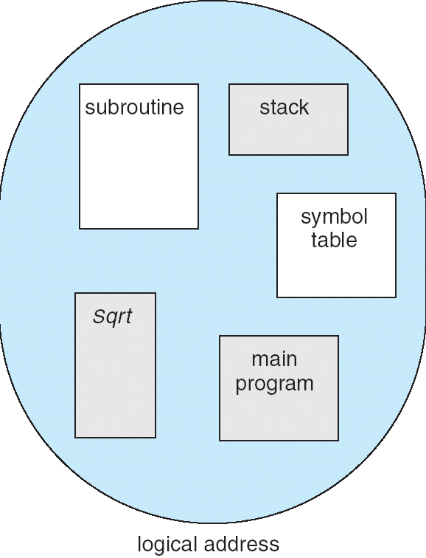
More Flexible Segmentation
1
1
1
4
2
3
2
2
4
3
user view of
memory space
physical
memory space
Logical View: multiple separate segments
Typical: Code, Data, Stack
Others: memory sharing, etc
Each segment is given region of contiguous memory
Has a base and limit
Can reside anywhere in physical memory

Slide 30
Implementation of Multi-Segment Model
Virtual
Address
offset
>
Seg #
Offset
Error
Base0
Limit0
V
Base1
Limit1
V
Base2
Limit2
V
Base2
Limit2
V
Base3
Limit3
N
+
Physical
Address
Base4
Limit4
V
Base5
Limit5
N
Base6
Limit6
N
Base7
Limit7
V
Check Valid
Segment map resides in processor
Segment number mapped into base/limit pair
Base added to offset to generate physical address
Error check catches offset out of range
As many chunks of physical memory as entries
Segment addressed by portion of virtual address
However, could be included in instruction instead:
x86 Example: mov [es:bx],ax.
What is “V/N” (valid / not valid)?
Can mark segments as invalid; requires check as well
Access
Error

Slide 31
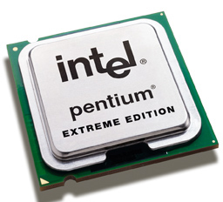
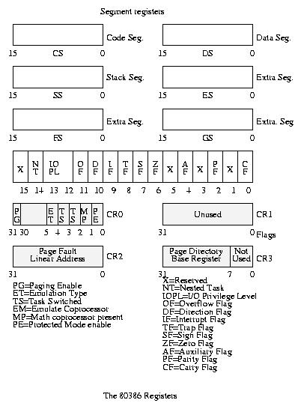
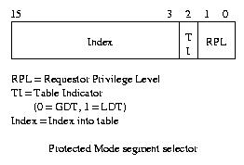
Intel x86 Special Registers
80386 Special Registers
Typical Segment Register
Current Priority is RPL
Of Code Segment (CS)

Slide 32
Example: Four Segments (16 bit addresses)
Seg ID # | Base | Limit
0 (code) | 0x4000 | 0x0800
1 (data) | 0x4800 | 0x1400
2 (shared) | 0xF000 | 0x1000
3 (stack) | 0x0000 | 0x3000
Seg
Offset
15
14
13
0
Virtual Address Format
0x0000
0x0000
0x4000
0x8000
0xC000
Virtual
Address Space
Physical
Address Space

Slide 33
Example: Four Segments (16 bit addresses)
Seg ID # | Base | Limit
0 (code) | 0x4000 | 0x0800
1 (data) | 0x4800 | 0x1400
2 (shared) | 0xF000 | 0x1000
3 (stack) | 0x0000 | 0x3000
Seg
Offset
15
14
13
0
Virtual Address Format
SegID = 0
0x0000
0x0000
0x4000
0x4000
0x4800
0x8000
0xC000
Virtual
Address Space
Physical
Address Space

Slide 34
Example: Four Segments (16 bit addresses)
Seg ID # | Base | Limit
0 (code) | 0x4000 | 0x0800
1 (data) | 0x4800 | 0x1400
2 (shared) | 0xF000 | 0x1000
3 (stack) | 0x0000 | 0x3000
Seg
Offset
15
14
13
0
Virtual Address Format
SegID = 0
0x0000
0x0000
SegID = 1
0x4000
Might
be shared
0x4000
0x4800
0x5C00
0x8000
Space for
Other Apps
0xC000
Shared with
Other Apps
Virtual
Address Space
Physical
Address Space

Slide 35
Example: Four Segments (16 bit addresses)
Seg ID # | Base | Limit
0 (code) | 0x4000 | 0x0800
1 (data) | 0x4800 | 0x1400
2 (shared) | 0xF000 | 0x1000
3 (stack) | 0x0000 | 0x3000
Seg
Offset
15
14
13
0
Virtual Address Format
SegID = 0
0x0000
0x0000
SegID = 1
0x4000
Might
be shared
0x4000
0x4800
0x5C00
0x8000
Space for
Other Apps
0xC000
0xF000
Shared with
Other Apps
Virtual
Address Space
Physical
Address Space

Slide 36
Administrivia
Deadline for 1st midterm regrades: Tomorrow, 10/9

Slide 37
break

Slide 38
Example of Segment Translation (16b address)
0x240 main: la $a0, varx 0x244 jal strlen
… …
0x360 strlen: li $v0, 0 ;count 0x364 loop: lb $t0, ($a0) 0x368 beq $r0,$t0, done
… …
0x4050 varx dw 0x314159
Seg ID # | Base | Limit
0 (code) | 0x4000 | 0x0800
1 (data) | 0x4800 | 0x1400
2 (shared) | 0xF000 | 0x1000
3 (stack) | 0x0000 | 0x3000
Let’s simulate a bit of this code to see what happens (PC=0x240):
Fetch 0x240. Virtual segment #? 0; Offset? 0x240
Physical address? Base=0x4000, so physical addr=0x4240
Fetch instruction at 0x4240. Get “la $a0, varx”
Move 0x4050 → $a0, Move PC+4→PC

Slide 39
Example of Segment Translation (16b address)
0x240 main: la $a0, varx 0x244 jal strlen
… …
0x360 strlen: li $v0, 0 ;count 0x364 loop: lb $t0, ($a0) 0x368 beq $r0,$t0, done
… …
0x4050 varx dw 0x314159
Seg ID # | Base | Limit
0 (code) | 0x4000 | 0x0800
1 (data) | 0x4800 | 0x1400
2 (shared) | 0xF000 | 0x1000
3 (stack) | 0x0000 | 0x3000
Let’s simulate a bit of this code to see what happens (PC=0x240):
Fetch 0x240. Virtual segment #? 0; Offset? 0x240
Physical address? Base=0x4000, so physical addr=0x4240
Fetch instruction at 0x4240. Get “la $a0, varx”
Move 0x4050 → $a0, Move PC+4→PC
Fetch 0x244. Translated to Physical=0x4244. Get “jal strlen” Move 0x0248 → $ra (return address!), Move 0x0360 → PC

Slide 40
Example of Segment Translation (16b address)
0x240 main: la $a0, varx 0x244 jal strlen
… …
0x360 strlen: li $v0, 0 ;count 0x364 loop: lb $t0, ($a0) 0x368 beq $r0,$t0, done
… …
0x4050 varx dw 0x314159
Seg ID # | Base | Limit
0 (code) | 0x4000 | 0x0800
1 (data) | 0x4800 | 0x1400
2 (shared) | 0xF000 | 0x1000
3 (stack) | 0x0000 | 0x3000
Let’s simulate a bit of this code to see what happens (PC=0x240):
Fetch 0x240. Virtual segment #? 0; Offset? 0x240
Physical address? Base=0x4000, so physical addr=0x4240
Fetch instruction at 0x4240. Get “la $a0, varx”
Move 0x4050 → $a0, Move PC+4→PC
Fetch 0x244. Translated to Physical=0x4244. Get “jal strlen” Move 0x0248 → $ra (return address!), Move 0x0360 → PC
Fetch 0x360. Translated to Physical=0x4360. Get “li $v0, 0” Move 0x0000 → $v0, Move PC+4→PC

Slide 41
Example of Segment Translation (16b address)
0x0240 main: la $a0, varx 0x0244 jal strlen
… …
0x0360 strlen: li $v0, 0 ;count 0x0364 loop: lb $t0, ($a0) 0x0368 beq $r0,$t0, done
… …
0x4050 varx dw 0x314159
Seg ID # | Base | Limit
0 (code) | 0x4000 | 0x0800
1 (data) | 0x4800 | 0x1400
2 (shared) | 0xF000 | 0x1000
3 (stack) | 0x0000 | 0x3000
Let’s simulate a bit of this code to see what happens (PC=0x0240):
Fetch 0x0240. Virtual segment #? 0; Offset? 0x240
Physical address? Base=0x4000, so physical addr=0x4240
Fetch instruction at 0x4240. Get “la $a0, varx”
Move 0x4050 → $a0, Move PC+4→PC
Fetch 0x0244. Translated to Physical=0x4244. Get “jal strlen” Move 0x0248 → $ra (return address!), Move 0x0360 → PC
Fetch 0x0360. Translated to Physical=0x4360. Get “li $v0, 0” Move 0x0000 → $v0, Move PC+4→PC
Fetch 0x0364. Translated to Physical=0x4364. Get “lb $t0, ($a0)” Since $a0 is 0x4050, try to load byte from 0x4050
Translate 0x4050 (0100 0000 0101 000). Virtual segment #? 1; Offset? 0x50 Physical address? Base=0x4800, Physical addr = 0x4850,
Load Byte from 0x4850→$t0, Move PC+4→PC

Slide 42
Observations about Segmentation
Virtual address space has holes
Segmentation efficient for sparse address spaces
A correct program should never address gaps (except as mentioned in moment)
If it does, trap to kernel and dump core
When it is OK to address outside valid range?
This is how the stack and heap are allowed to grow
For instance, stack takes fault, system automatically increases size of stack
Need protection mode in segment table
For example, code segment would be read-only
Data and stack would be read-write (stores allowed)
Shared segment could be read-only or read-write
What must be saved/restored on context switch?
Segment table stored in CPU, not in memory (small)
Might store all of processes memory onto disk when switched (called “swapping”)

Slide 43
Problems with Segmentation
Must fit variable-sized chunks into physical memory
May move processes multiple times to fit everything
Limited options for swapping to disk
Fragmentation: wasted space
External: free gaps between allocated chunks
Internal: don’t need all memory within allocated chunks

Slide 44
Recall: General Address Translation
Code
Data
Heap
Stack
Data 2
Code
Data
Heap
Stack
Stack 1
Heap 1
Code 1
Stack 2
Prog 1
Virtual
Address
Space 1
Data 1
Prog 2
Virtual
Address
Space 2
Heap 2
Code 2
OS code
Translation Map 1
OS data
Translation Map 2
OS heap &
Stacks
Physical Address Space

Slide 45
Paging: Physical Memory in Fixed Size Chunks
Solution to fragmentation from segments?
Allocate physical memory in fixed size chunks (“pages”)
Every chunk of physical memory is equivalent
Can use simple vector of bits to handle allocation: 00110001110001101 … 110010
Each bit represents page of physical memory 1 ⇒ allocated, 0 ⇒ free
Should pages be as big as our previous segments?
No: Can lead to lots of internal fragmentation
Typically have small pages (1K-16K)
Consequently: need multiple pages/segment

Slide 46
How to Implement Paging?
Virtual Address:
Virtual
Page #
Offset
PageTablePtr
page #0
V,R
Physical
Page #
Offset
page #1
V,R
page #1
V,R
page #2
V,R,W
Physical Address
PageTableSize
>
page #3
V,R,W
Check Perm
Access Error
page #4
N
page #5
V,R,W
Access
Error
Page Table (One per process)
Resides in physical memory
Contains physical page and permission for each virtual page
Permissions include: Valid bits, Read, Write, etc
Virtual address mapping
Offset from Virtual address copied to Physical Address
Example: 10 bit offset ⇒ 1024-byte pages
Virtual page # is all remaining bits
Example for 32-bits: 32-10 = 22 bits, i.e. 4 million entries
Physical page # copied from table into physical address
Check Page Table bounds and permissions

Slide 47
Simple Page Table Example
Example (4 byte pages)
0x00
0000 0000
0x00
a
b
c
d
0001 0000
0x04
0
4
i
j
k
l
0x04
0000 0100
1
0000 1100
0x05!
e
f
g
h
3
2
1
0000 0100
0x08
0x06?
0x08
0000 1000
Page
Table
0x0C
i
j
k
l
e
f
g
h
0x09?
0x0E!
0x10
Virtual
Memory
0000 0110
0000 1110
a
b
c
d
0000 1001
0000 0101
Physical
Memory
Notes:
What is virtual address 0x6? 1|10 = 3|2 = 0xE
What is virtual address 0x9? 10|01 = 1|1 = 0x5

Slide 48
What about Sharing?
Virtual Address
(Process A):
Virtual
Page #
Offset
PageTablePtrA
page #0
V,R
page #1
V,R
page #2
V,R,W
page #2
V,R,W
page #3
V,R,W
Shared
Page
page #4
N
page #5
V,R,W
PageTablePtrB
page #0
V,R
page #1
N
This physical page
appears in address
space of both processes
page #2
V,R,W
page #3
N
page #4
V,R
page #4
V,R
page #5
V,R,W
Virtual Address
(Process B):
Virtual
Page #
Offset

Slide 49
Summary: Paging
Page Table
Virtual memory view
Physical memory view
1111 1111
11111 11101
11110 11100
11101 null
11100 null
11011 null
11010 null
11001 null
11000 null
10111 null
10110 null
10101 null
10100 null
10011 null
10010 10000
10001 01111
10000 01110
01111 null
01110 null
01101 null
01100 null
01011 01101
01010 01100
01001 01011
01000 01010
00111 null
00110 null
00101 null
00100 null
00011 00101
00010 00100
00001 00011
00000 00010
1110 1111
1111 0000
stack
stack
1110 0000
1100 0000
heap
1000 0000
heap
0111 000
data
data
0101 000
0100 0000
code
code
0001 0000
0000 0000
0000 0000
page #
offset

Slide 50
Summary: Paging
Page Table
Virtual memory view
Physical memory view
1111 1111
11111 11101
11110 11100
11101 null
11100 null
11011 null
11010 null
11001 null
11000 null
10111 null
10110 null
10101 null
10100 null
10011 null
10010 10000
10001 01111
10000 01110
01111 null
01110 null
01101 null
01100 null
01011 01101
01010 01100
01001 01011
01000 01010
00111 null
00110 null
00101 null
00100 null
00011 00101
00010 00100
00001 00011
00000 00010
stack
1110 0000
stack
1110 0000
1100 0000
What happens if stack grows to 1110 0000?
heap
1000 0000
heap
0111 000
data
data
0101 000
0100 0000
code
code
0001 0000
0000 0000
0000 0000
page #
offset

Slide 51
Summary: Paging
Page Table
Virtual memory view
Physical memory view
1111 1111
11111 11101
11110 11100
11101 10111
11100 10110
11011 null
11010 null
11001 null
11000 null
10111 null
10110 null
10101 null
10100 null
10011 null
10010 10000
10001 01111
10000 01110
01111 null
01110 null
01101 null
01100 null
01011 01101
01010 01100
01001 01011
01000 01010
00111 null
00110 null
00101 null
00100 null
00011 00101
00010 00100
00001 00011
00000 00010
stack
1110 0000
stack
1110 0000
1100 0000
stack
Allocate new pages where room!
heap
1000 0000
heap
0111 000
data
Challenge: Table size equal to # of pages in virtual memory!
data
0101 000
0100 0000
code
code
0001 0000
0000 0000
0000 0000
page #
offset

Slide 52
Page Table Discussion
What needs to be switched on a context switch?
Page table pointer and limit
Analysis
Pros
Simple memory allocation
Easy to share
Con: What if address space is sparse?
E.g., on UNIX, code starts at 0, stack starts at (2³¹-1)
With 1K pages, need 2 million page table entries!
Con: What if table really big?
Not all pages used all the time ⇒ would be nice to have working set of page table in memory
How about multi-level paging or combining paging and segmentation?
Notes:
What if page size is very small? VAX had a 512-byte page size = lots of space for page table entries
What if page size is really big? Wastes space inside of page (internal fragmentation)

Slide 53
Fix for sparse address space: The two-level page table
Physical
Address:
Physical
Page #
Offset
10 bits
10 bits
12 bits
Virtual
Address:
Virtual
P1 index
Virtual
P2 index
Offset
4KB
PageTablePtr
4 bytes
Tree of Page Tables
Tables fixed size (1024 entries)
On context-switch: save single PageTablePtr register
Valid bits on Page Table Entries
Don’t need every 2nd-level table
Even when exist, 2nd-level tables can reside on disk if not in use
4 bytes

Slide 54
Summary: Two-Level Paging
Virtual memory view
Page Tables
(level 2)
Physical memory view
1111 1111
stack
11 11101
10 11100
01 10111
00 10110
stack
1110 0000
1111 0000
1100 0000
Page Table
(level 1)
stack
111
110 null
101 null
100
011 null
010
001 null
000
11 null
10 10000
01 01111
00 01110
heap
1000 0000
heap
0111 000
11 01101
10 01100
01 01011
00 01010
data
data
0101 000
0100 0000
11 00101
10 00100
01 00011
00 00010
code
page2 #
code
0001 0000
0000 0000
0000 0000
page1 #
offset

Slide 55
Summary: Two-Level Paging
Virtual memory view
Page Tables
(level 2)
Physical memory view
stack
11 11101
10 11100
01 10111
00 10110
stack
1110 0000
Page Table
(level 1)
stack
111
110 null
101 null
100
011 null
010
001 null
000
11 null
10 10000
01 01111
00 01110
1001 0000
(0x90)
heap
heap
1000 0000
(0x80)
In best case, total size of page tables ≈ number of pages used by program virtual memory. Requires two additional memory access!
11 01101
10 01100
01 01011
00 01010
data
data
11 00101
10 00100
01 00011
00 00010
code
code
0001 0000
0000 0000

Slide 56
Multi-level Translation: Segments + Pages
What about a tree of tables?
Lowest level page table ⇒ memory still allocated with bitmap
Higher levels often segmented
Could have any number of levels. Example (top segment):
What must be saved/restored on context switch?
Contents of top-level segment registers (for this example)
Pointer to top-level table (page table)
Virtual
Address:
Virtual
Seg #
Virtual
Page #
Offset
page #0
V,R
Base0
Limit0
V
page #1
V,R
Physical
Page #
Offset
page #2
V,R,W
Base1
Limit1
V
page #2
V,R,W
Physical Address
Base2
Limit2
V
page #3
V,R,W
Base2
Limit2
V
Base3
Limit3
N
page #4
N
Base4
Limit4
V
page #5
V,R,W
Check Permissions
Base5
Limit5
N
Base6
Limit6
N
Base7
Limit7
V
>
Access
Error
Access
Error

Slide 57
What about Sharing (Complete Segment)?
Process A
Virtual
Seg #
Virtual
Page #
Offset
page #0
V,R
page #1
V,R
page #2
V,R,W
Base0
Limit0
V
page #3
V,R,W
Base1
Limit1
V
page #4
N
Base2
Limit2
V
Base2
Limit2
V
page #5
V,R,W
Base3
Limit3
N
Base4
Limit4
V
Shared Segment
Base5
Limit5
N
Base6
Limit6
N
Base0
Limit0
V
Base7
Limit7
V
Base1
Limit1
V
Base2
Base2
Limit2
Limit2
V
V
Base3
Limit3
N
Base4
Limit4
V
Base5
Limit5
N
Base6
Limit6
N
Base7
Limit7
V
Process B
Virtual
Seg #
Virtual
Page #
Offset

Slide 58
Multi-level Translation Analysis
Pros:
Only need to allocate as many page table entries as we need for application
In other wards, sparse address spaces are easy
Easy memory allocation
Easy Sharing
Share at segment or page level (need additional reference counting)
Cons:
One pointer per page (typically 4K – 16K pages today)
Page tables need to be contiguous
However, previous example keeps tables to exactly one page in size
Two (or more, if >2 levels) lookups per reference
Seems very expensive!

Slide 59
Summary
Segment Mapping
Segment registers within processor
Segment ID associated with each access
Often comes from portion of virtual address
Can come from bits in instruction instead (x86)
Each segment contains base and limit information
Offset (rest of address) adjusted by adding base
Page Tables
Memory divided into fixed-sized chunks of memory
Virtual page number from virtual address mapped through page table to physical page number
Offset of virtual address same as physical address
Large page tables can be placed into virtual memory
Multi-Level Tables
Virtual address mapped to series of tables
Permit sparse population of address space

